Slide 1


Live Typing Update & What’s next
Hernán A. Wilkinson - @hernanwilkinson
10Pines founder – Professor at UBA
agile software development & services

Slide 2
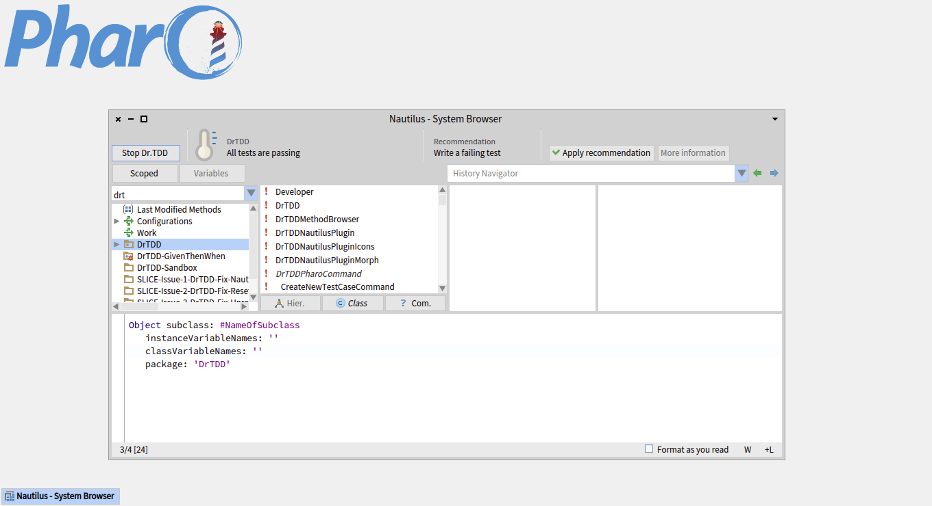
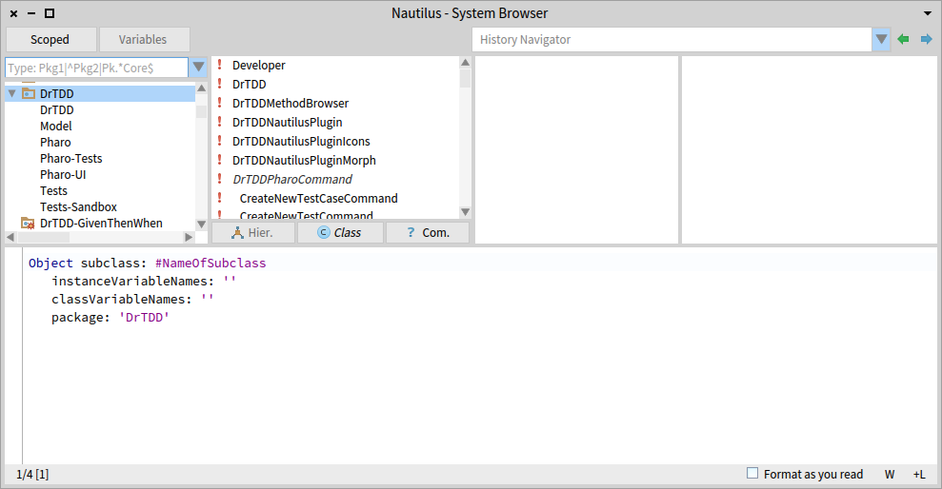
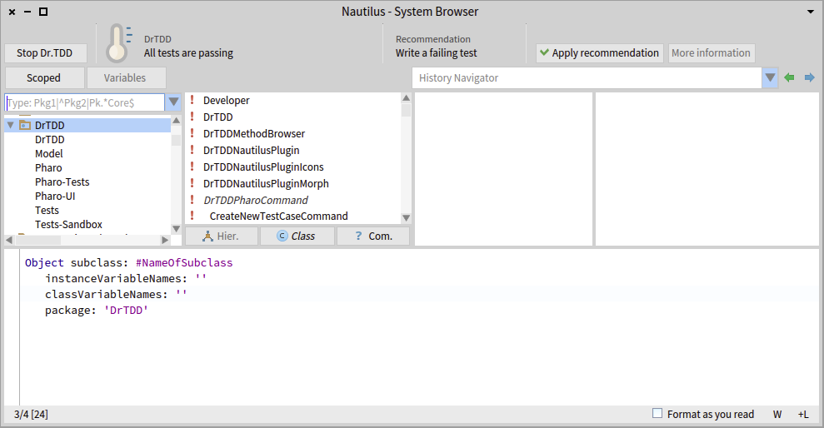

“Wilklippy”

Slide 3
We all know that Smalltalk is cool

Slide 4
Because it is Dynamically Typed

Slide 5
Because it is a Live Environment and many more features…

Slide 6
But we all also know that …

Slide 7
There is “missing information” in
Smalltalk

Slide 8
That missing information is Type Information

Slide 9
We, programmers, have to remember and infer that information
That takes time & energy from us

Slide 10
Why don’t we take that time & energy from the computer?

Slide 11
Bret Victor – Inventing on a Principle ‘we are use to play computers’

Slide 12
Unknow Smalltalker: ‘we are use to play memory games with types’

Slide 13
It is time to stop loosing time & energy on that

Slide 14
It is time to stop getting invalid senders of a message

Slide 15
It is time to stop getting more implementors that the real ones we are looking for

Slide 16
It is time to stop fearing a Message Rename

Slide 17
It is time to stop getting invalid suggestions from the Autocomplete

Slide 18
It’s time to admit that Smalltalk is not perfect

Slide 19
It’s time to act!

Slide 20
Live Typing
Automatic type annotation (done by the VM)
+
Tools to improve the development experience
(Annotation happens while the system runs)

Slide 21
It is not a new idea…

Slide 22
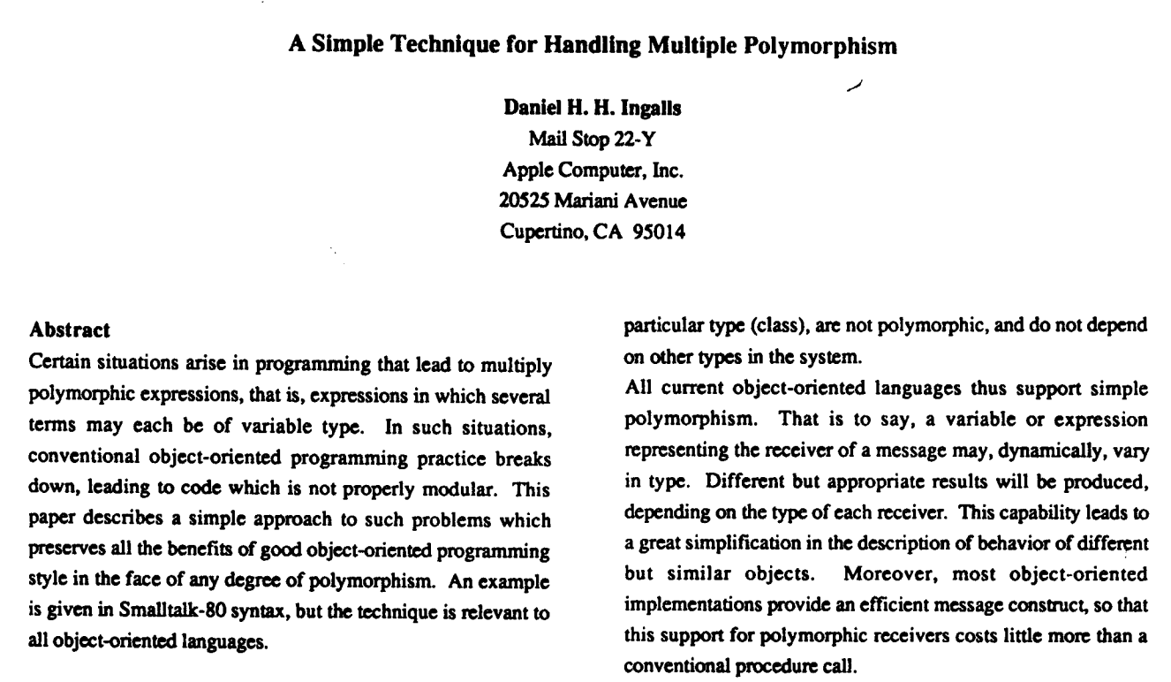
Since 1986!

Slide 23
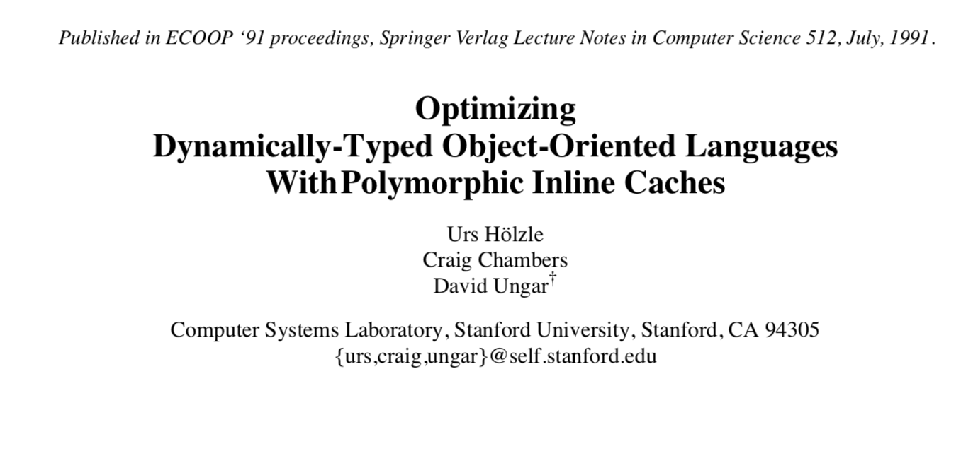

Slide 24
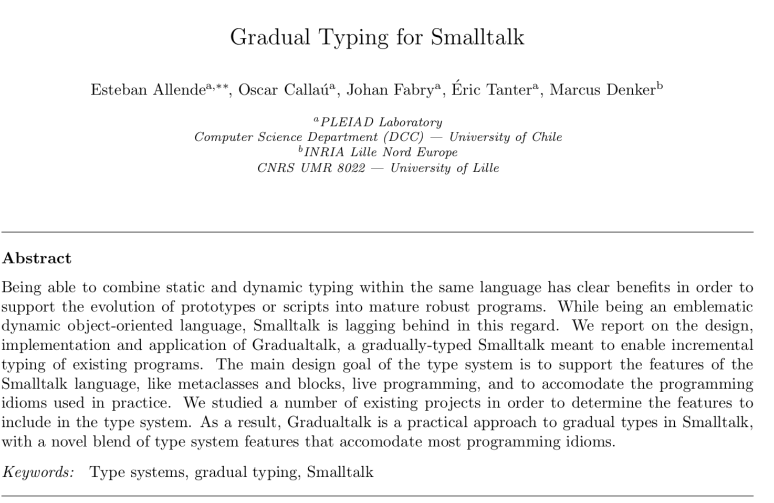

Slide 25

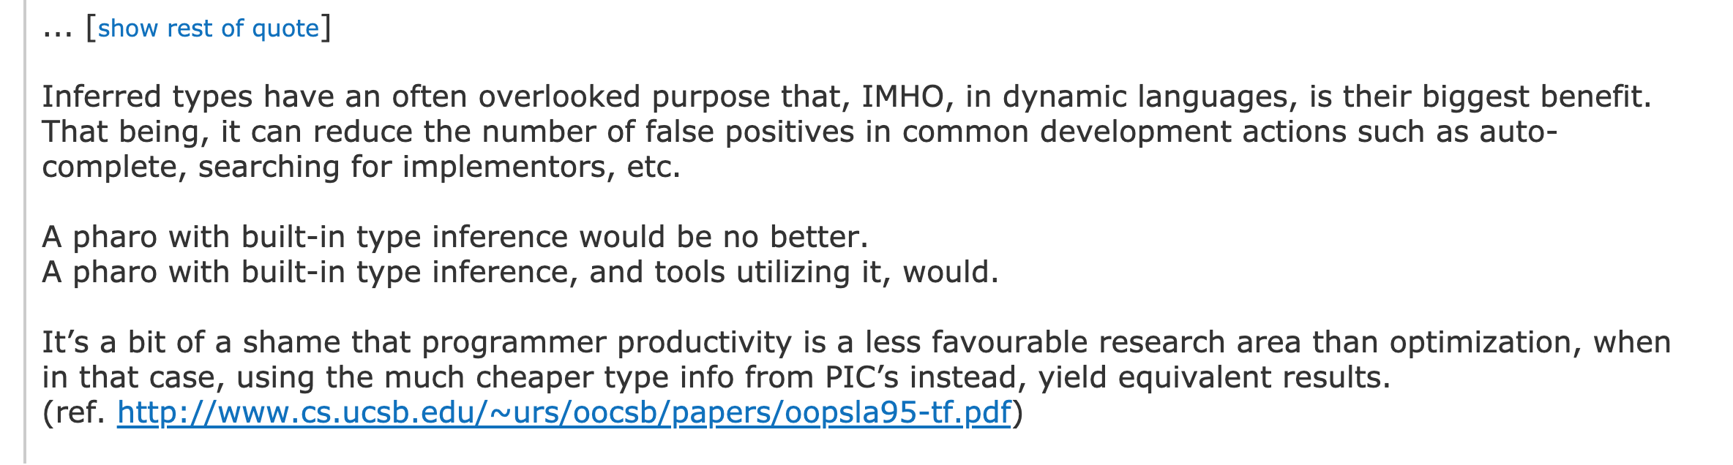

Slide 26
It is not a new idea but… It is a particular one with a working implementation

Slide 27
Live Typing is not about type checking in the “classic way”

Slide 28
Live Typing is about making programming easily

Slide 29
Tools Examples

Slide 30
TicTacToe

Slide 31
Showing/Managing Types

Slide 32
Really useful for “legacy” code Thank you Pocho for the tip on the balloon help!

Slide 33
Autocompletion a = b → what messages should be shown?

Slide 34
DynamicType (SelfType, ClassType, InstanceType) Thank you Jan Vrany & Marcus Denker

Slide 35
Actual Implementors (“a much better use of the human brain”-Tudor et al ☺)

Slide 36
Actual Senders Sure and Possible (Per Message Send analysis)

Slide 37
How can we know if #accept: is sent to SelectorNode only when visiting a MessageNode?

Slide 38
Refactorings with Actual Scope

Slide 39
Type Checker (we know for sure when nil is assigned!)

Slide 40
Type Check Morph & Behavior

Slide 41
LiveTyping in Pharo

Slide 42
Conclusion

Slide 43
With no extra effort, we were able to get rid off of most of the disadvantages

Slide 44
You don’t have to maintain the types It does not interfere when reading code

Slide 45
Live Typing makes types explicit You do not have to remember or infer them anymore

Slide 46
It is a very simple technique that heavily improves the programming experience

Slide 47
It does not change the syntax It does not stop you from compiling It does not force you to use it Types are not in the source code

Slide 48
I humbly believe it respects and honors the Smalltalk spirit

Slide 49
My Goal?

Slide 50
To say that Smalltalk is not Dynamically Typed anymore, but Lively Typed

Slide 51
Future Work

Slide 52
Under development
Annotate types in closure parameters and variables (Ines Sosa)
Support for Parameterized types (Generics) is needed for collections, association, etc. (Collection<T>, Association<K,V>, etc.) (Ana Felisatti & Mariano De Sousa)
Implement it on the JIT VM (Federico Grosso)

Slide 53
More Ideas
Add more type cast cases in the Type Checker
Check for parameter types (Freeze annotated types)
Use Type Checker infrastructure to improve even more the autocomplete
Suggest only the objects that type check for parameters
Import type info from production images to development images
Improve Type Checker to warn about dead code
Delete method with transitive closure of actual sends in that method
Change the COMPILER (not the VM) to generate and initialize the PIC at compile time!!

Slide 54
Download it from:
One Click - CuisUniversity: http://www.cuisuniversity.org/
soon in the main Cuis distribution!
Just the Image: https://github.com/hernanwilkinson/LiveTyping/tree/master/Smalltalk/image
Just the VM: https://github.com/hernanwilkinson/LiveTyping/tree/master/Smalltalk/VMs
The repo: https://github.com/hernanwilkinson/LiveTyping

Slide 55
Thanks! @HernanWilkinson – hernan.wilkinson@10pines.com – www.10pines.com

